Slide 1
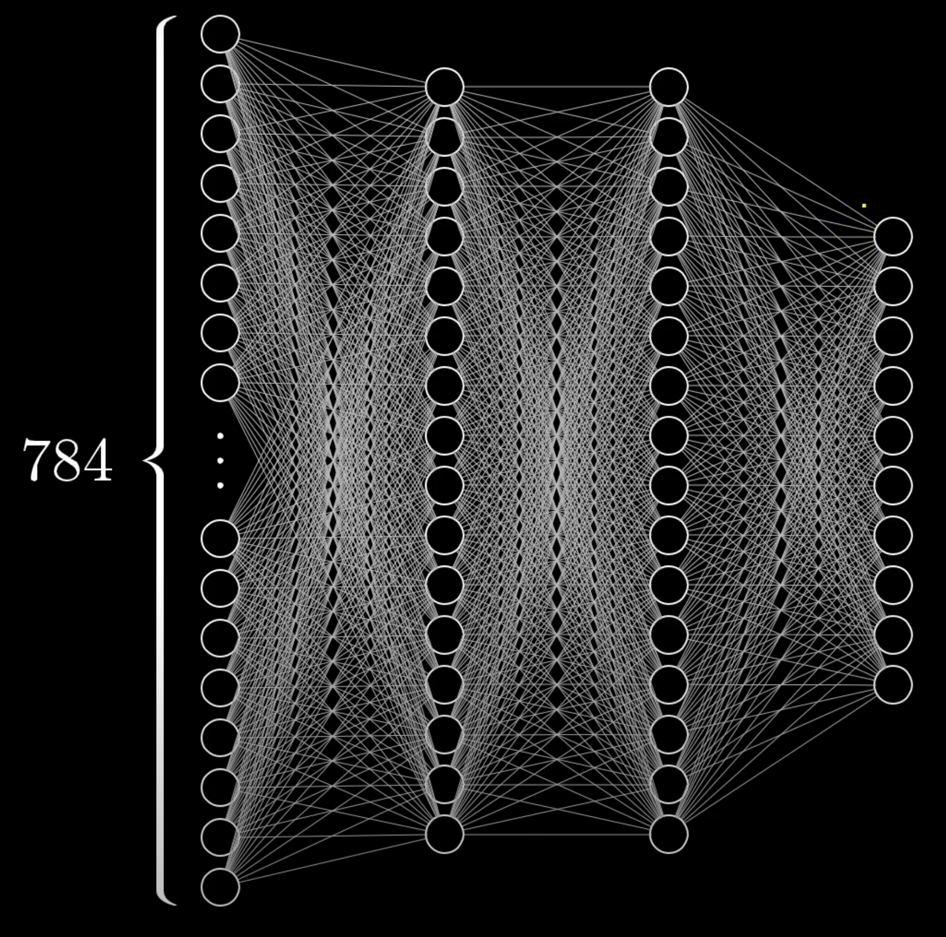
Input
Hidden Layers
Output

Slide 2




Slide 3
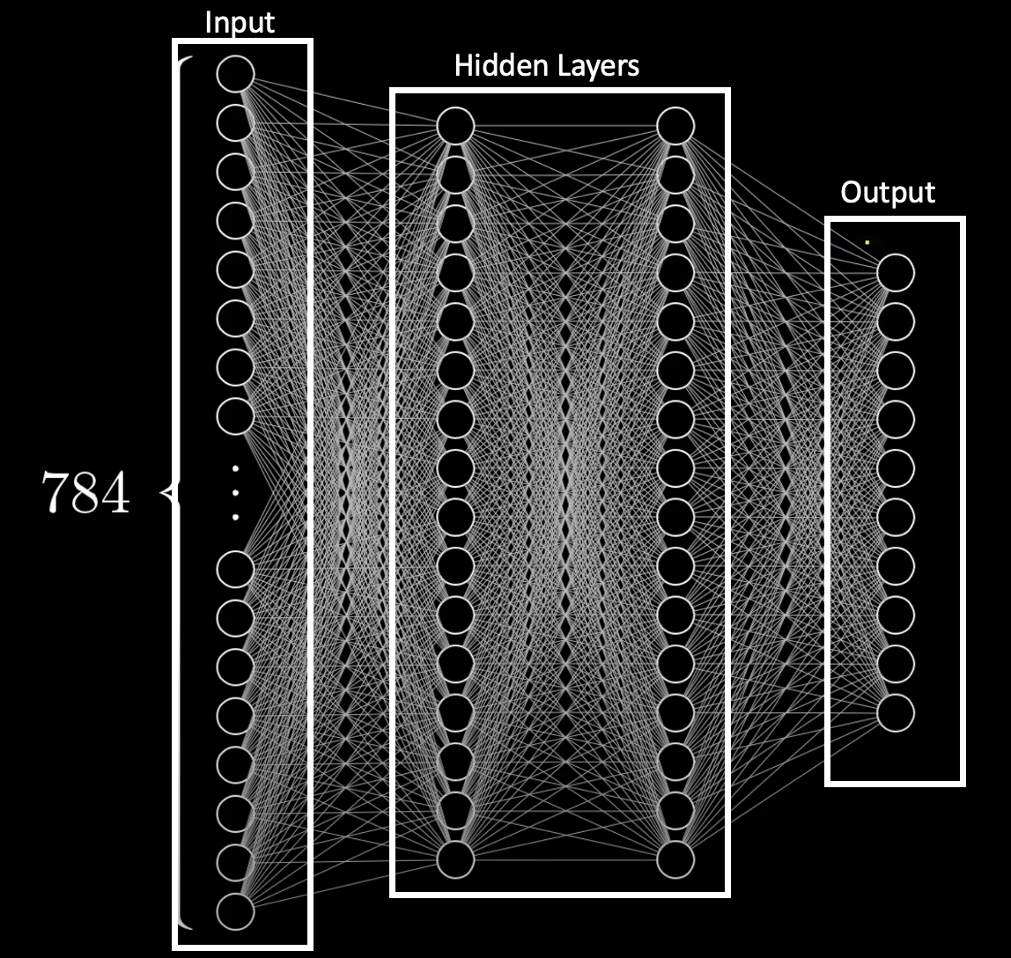
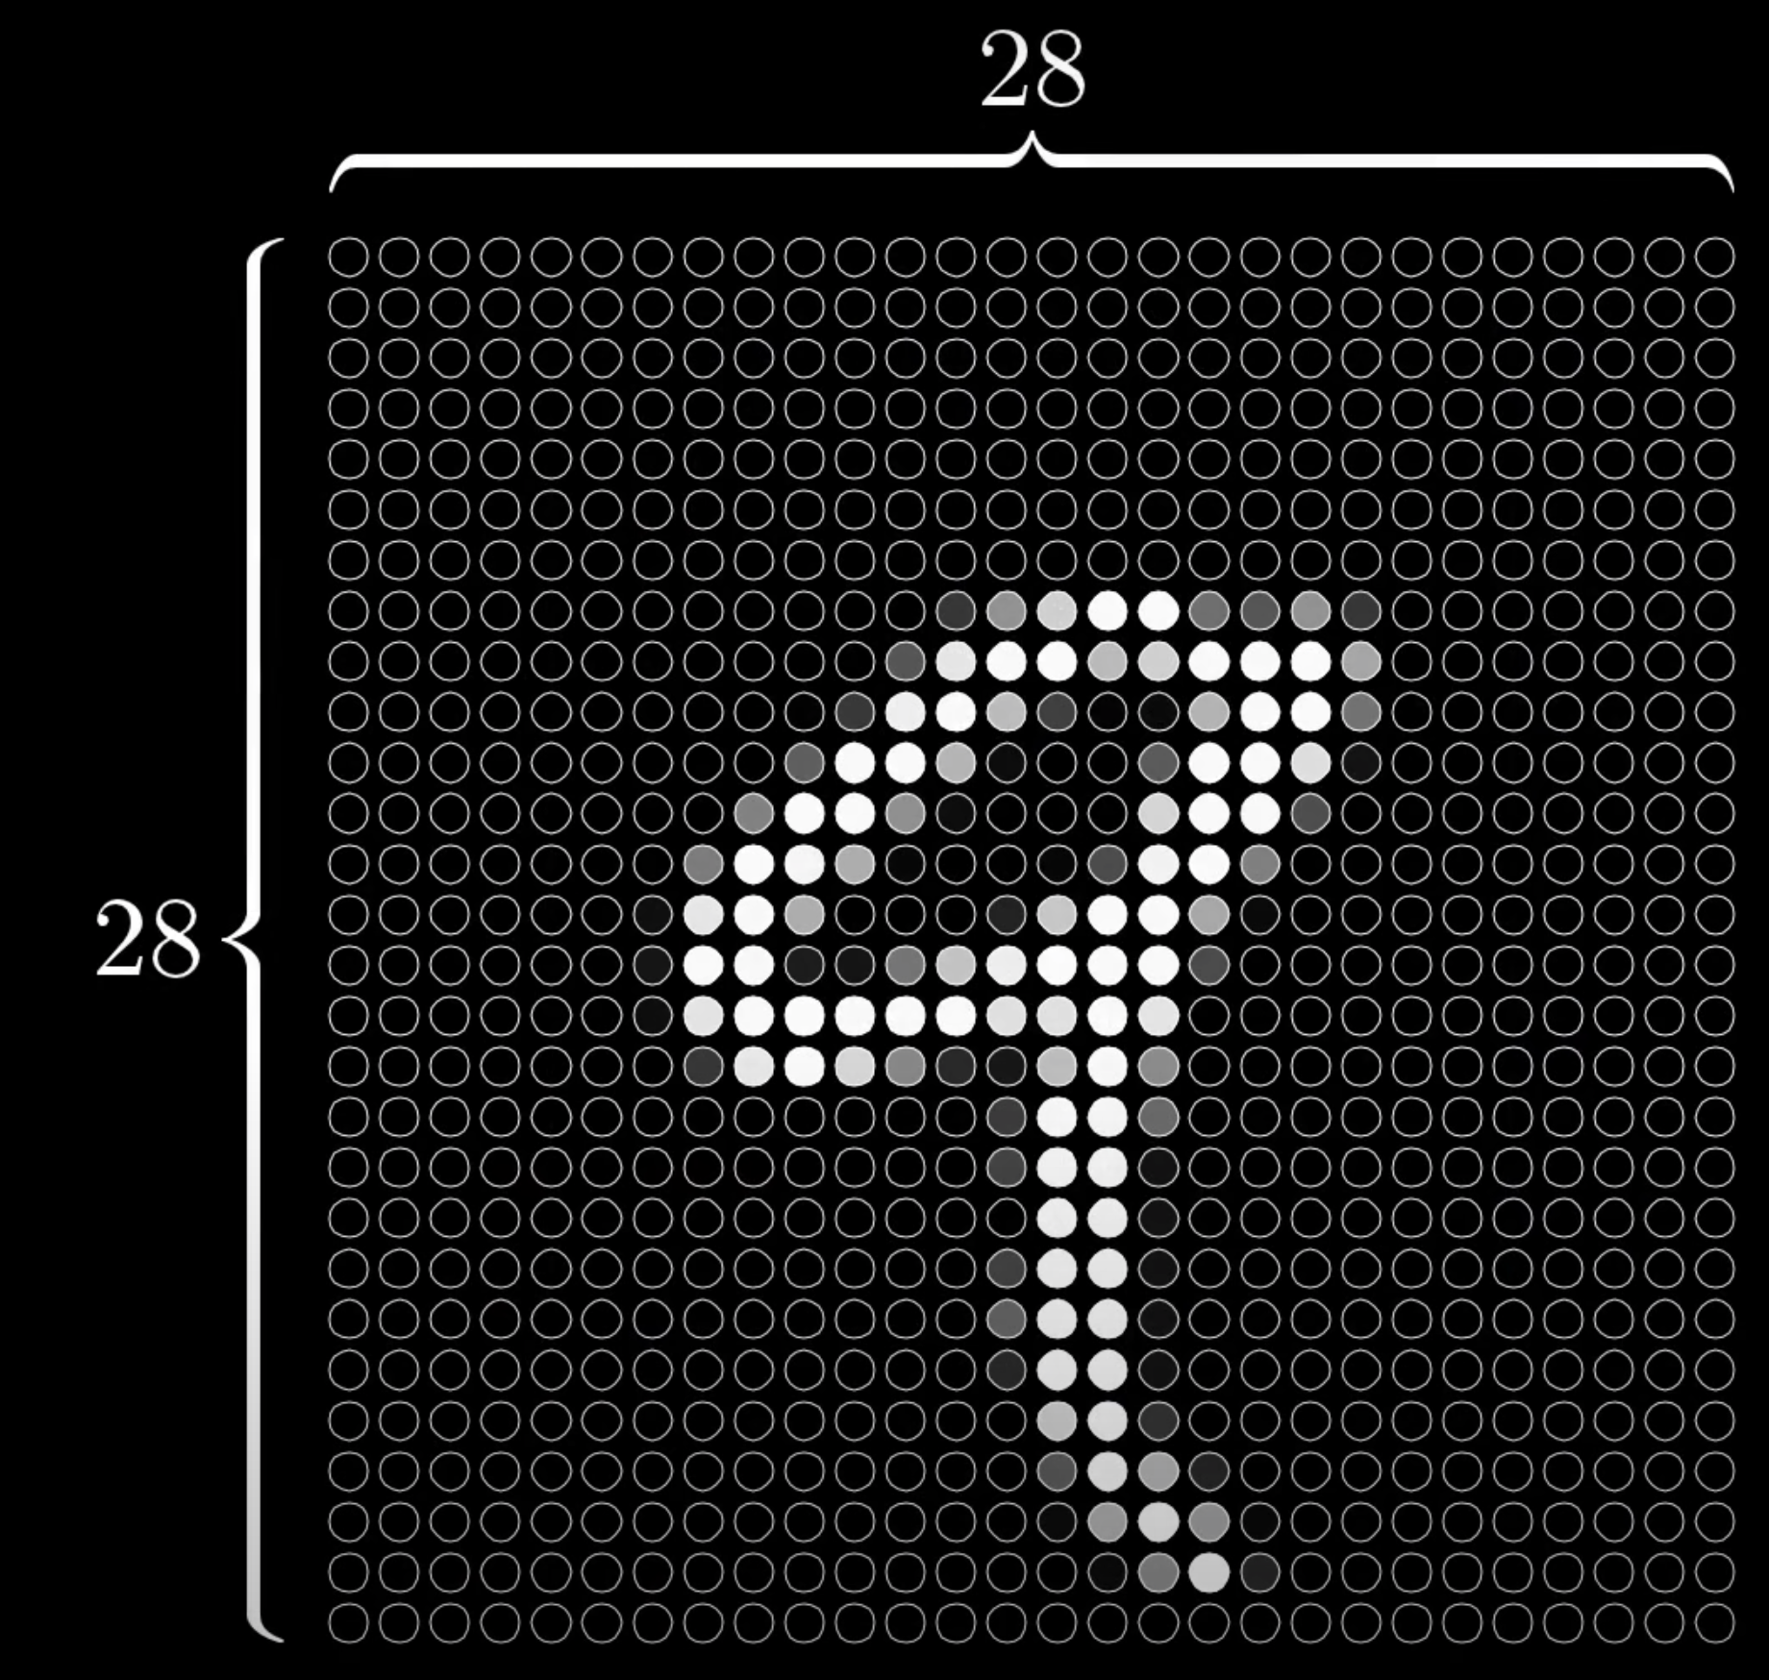
A
B

Slide 4
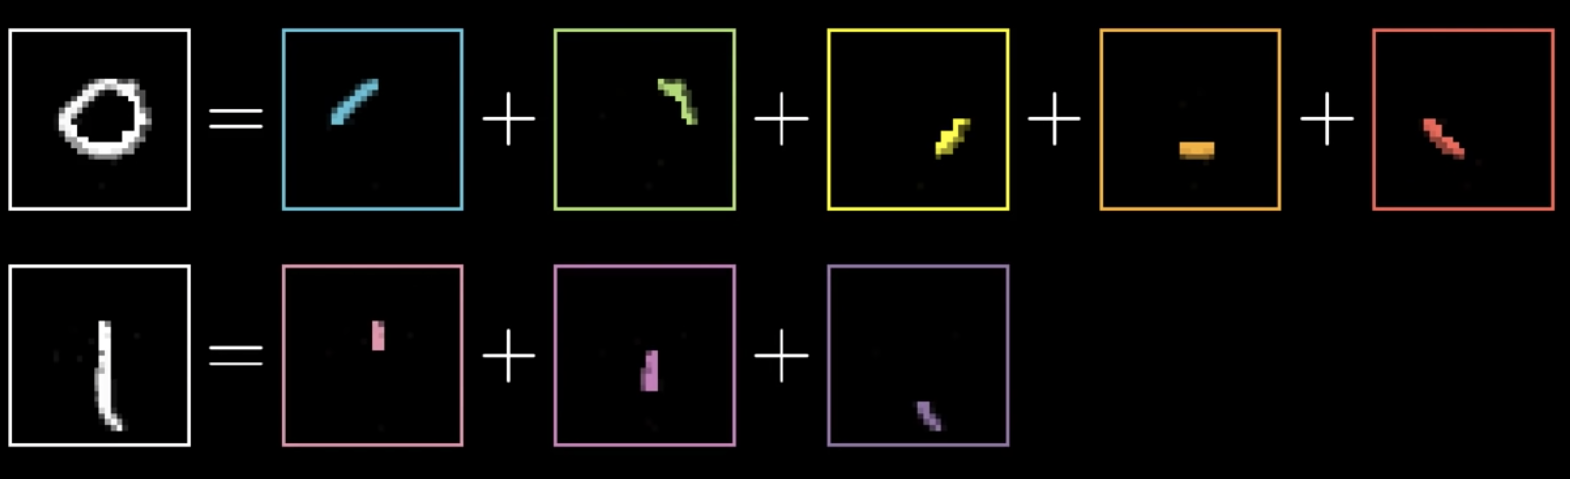
A
B

Slide 5
Phase 1:
Phase 2:
Phase 3:
Phase 4:
Preprocess datasets
Preprocess datasets
Preprocess datasets
Preprocess datasets
Train OLID
Train HASOC
Train OLID
Train HASOC
Train OLID
Train HASOC
Train HASOC & OLID
Test OLID
Test HASOC
Test HASOC
Test OLID
Perturbate Test OLID
Perturbate
Test HASOC
Perturbate Test OLID
Perturbate
Test HASOC
evaluate
evaluate
evaluate
evaluate

Slide 6
Phase 1
Phase 2
Phase 3
Phase 4
Preprocess datasets
Preprocess datasets
Preprocess datasets
Preprocess datasets
Train OLID
Train HASOC
Train OLID
Train HASOC
Train OLID
Train HASOC
Train OLID
Train HASOC
Test OLID
Test HASOC
Test perturbated OLID
Test perturbated HASOC
Test HASOC
Test OLID
Test perturbated HASOC
Test perturbated OLID
evaluate
evaluate
evaluate
evaluate

Slide 7
Test OLID
Train OLID
Test perturbated OLID
Test HASOC
Preprocess datasets
Test perturbated HASOC
evaluate
Test HASOC
Train HASOC
Test perturbated HASOC
Test OLID
Test perturbated OLID

